Slide 1
Electric Production Trends and Seasonal Analysis (1985-2018)
Presented by
Pappula Madhusudhan reddy

Slide 2
Dataset Overview
Source: Electric_Production.csv
Time range: 1985-2018
Frequency: Monthly observations
Variable:
Date
Electric Production Index
The dataset contains monthly electric production index values over a 34-year period, allowing for long-term trend and seasonal pattern analysis.

Slide 3
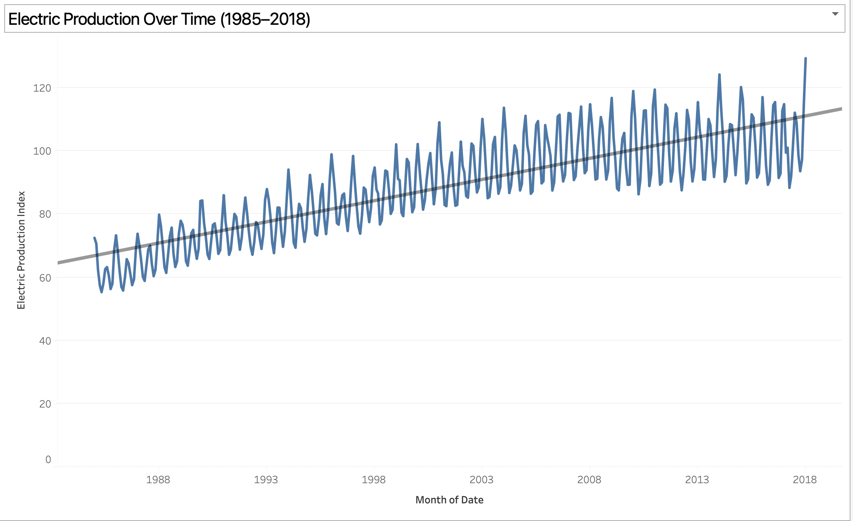
LONG-TERM PRODUCTION GROWTH

Slide 4
MONTHLY PRODUCTION VS 12-MONTH MOVING AVERAGE

Slide 5
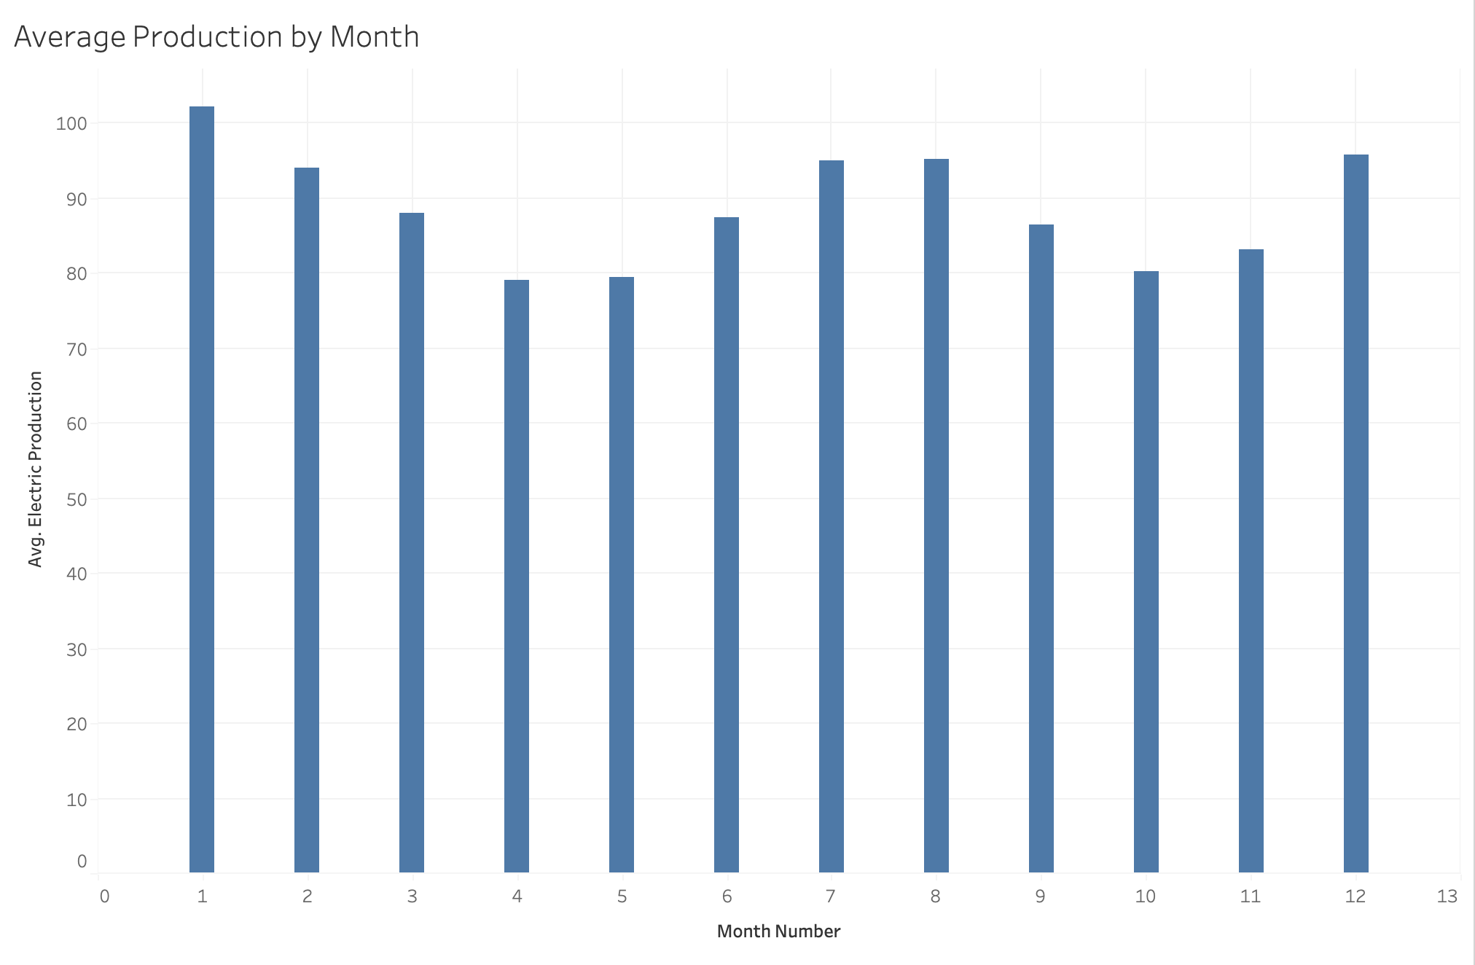
SEASONAL PRODUCTION PATTERNS

Slide 6
KEY TAKEAWAYS & RECOMMENDATIONS
KEY TAKEAWAYS:
Production increased from ~60 (1985) to ~110+ (2018), nearly doubling over 34 years.
Growth slowed significantly after 2008, with a flatter 12-month moving average trend.
Production consistently peaks mid-year (July-Aug) and declines in early-year months (Jan-Feb).
Seasonal Variation avg approx. 15-20 index points between peak and trough months.
RECOMMENDATIONS:
Increase reserve generation capacity during peak summer months.
Use seasonal forecasting models (e.g., ARIMA) for load planning.
Monitor structural demand changes post-2008 to adjust long-term infrastructure investment.

Slide 7
LIMITATIONS & REFERENCES
LIMITATIONS:
No regional breakdown.
No weather or fuel cost variables.
Index-based measurement (not absolute production).
Seasonal pattern assumed consistent nationally (no regional validation)
REFERENCES:
Electric_Production.csv. (2026). MIS7397 Course Dataset. Provided by course instructor.
Tableau Software, LLC. (2025). Tableau Desktop Professional Edition (Version 2025.3.3; Mac with Apple silicon).Salesforce, Inc.
MIS7397 Course Materials. (2026). University course resources.

